Slide 1

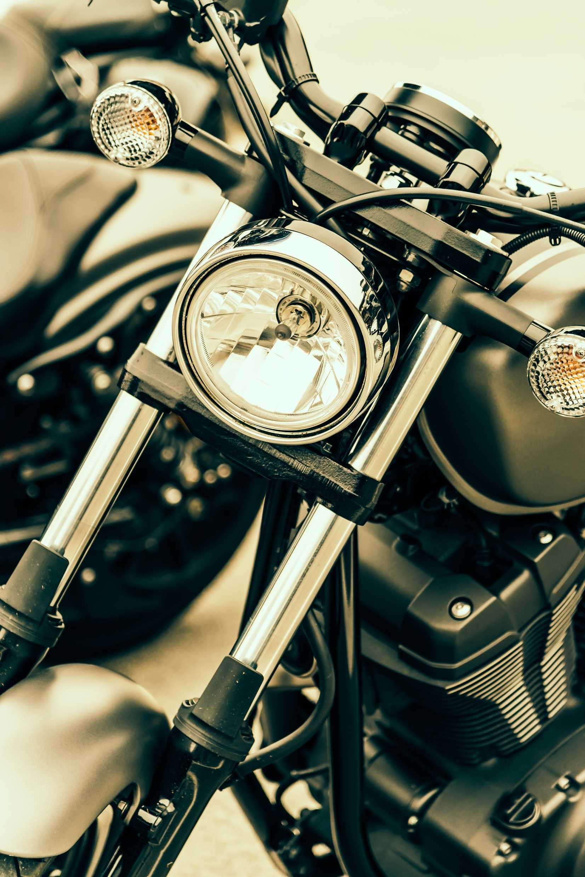
BIKE
Bike Source
A two-wheeled motorized vehicle with an engine.

Slide 2



Our Team
Debodipto Samadder
ID: 21201079
Amirul Islam Papon
ID: 21201076
Shomit Chandra Das
ID: 21201083

Slide 3

Project Overview
BIKE
Bike Buy and Sell is an online platform connecting bike buyers and sellers. It offers easy listings, browsing, secure communication, and verified transactions to ensure a seamless buying and selling experience.

Slide 4

Problem Statement
The process of buying and selling bikes is inefficient, time-consuming, and lacks a centralized,trusted platform. Buyers struggle to find reliable sellers, while sellers face difficulties reaching the right audience. Our platform solves this by offering a dedicated, transparent, and seamless solution.
BIKE

Slide 5
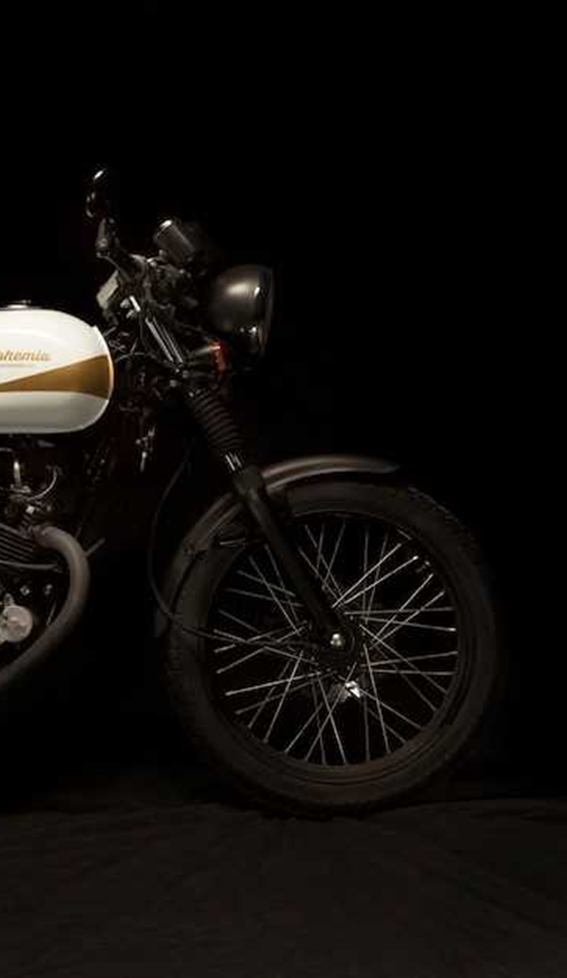
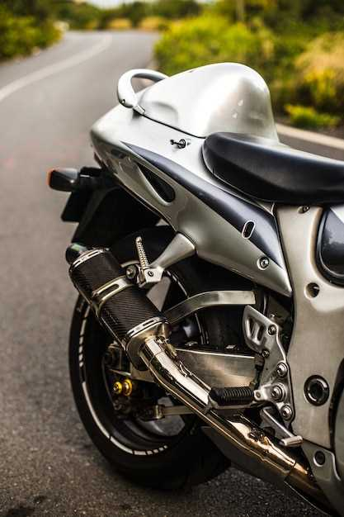
01
Build a user-friendly bike trading platform
02
Ensure a secure, verified transactions
Project Objectives
03
Simplify searching and filtering for buyers and sellers
04
Foster a trusted bike enthusiast community

Slide 6
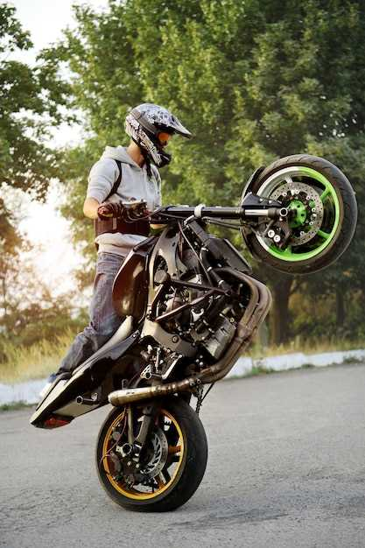
Key Features
01
User Registration & Profile
Bike listing with photos and descriptions
02
BIKE
03
Advanced search and filtering system
04
Real time messaging system
05
Review and rating system

Slide 7
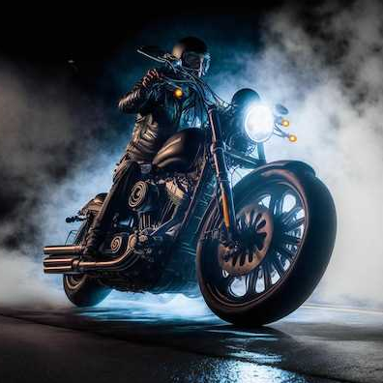
System Architecture
BIKE
User Interface (UI/Frontend)
Application Layer (Django Backend)
Database Layer
Security Layer
Communication Layer

Slide 8

Technology Stack
01
BIKE
Frontend: HTML, CSS, JavaScript
02
Backend: Python, Django
03
Database: db sqlite

Slide 9
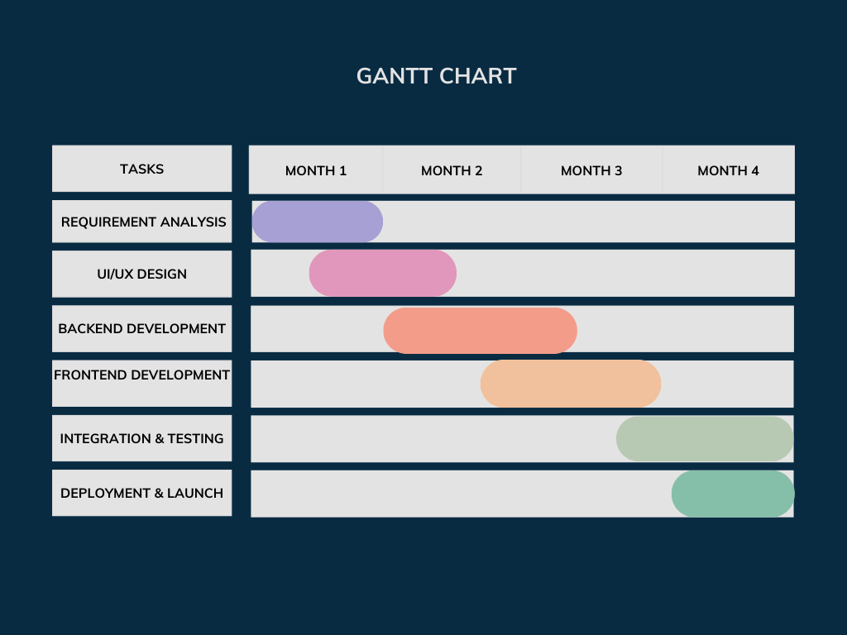
Development Plan

Slide 10
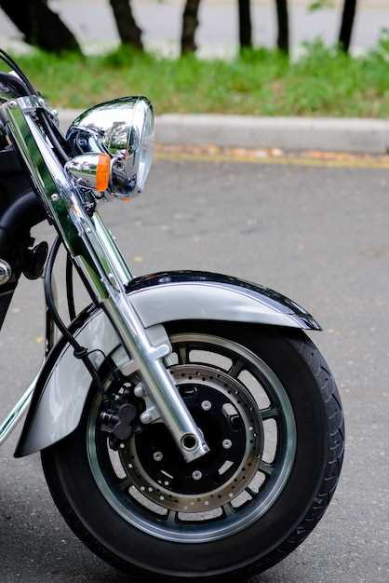
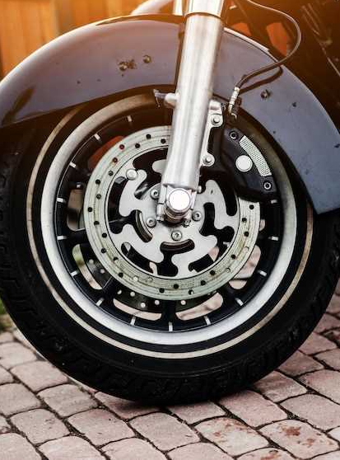
Conclusion
Bike Buy and Sell aims to simplify and enhance the bike trading process through a secure, user-friendly platform. By connecting buyers and sellers with verified listings and seamless transactions, the platform will create a trusted community for bike enthusiasts.
BIKE

Slide 11
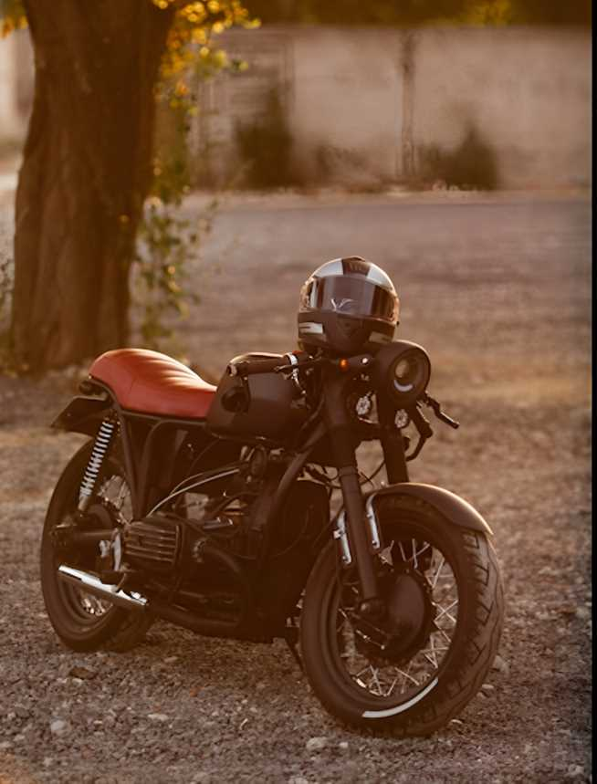
BIKE
Thank You

